Slide 1
Estimating the Causal Impact of Laws Using BART for Subpopulations
Yanming Zhang

Slide 2
Problem Formulation
Background: When a epidemic outbreak happens, we want to enforce the most effective laws relevant to the epidemic outcomes such as opioid death rate.
Goal: Be able to accurately measure the effectiveness of relevant laws and warn counties that are at risk for the epidemic outcomes.
Method: Not merely investigate the correlation between laws and outcomes but the causal relationship between. A superior causal inference method Bayesian Additive Regression Tree (BART) is implemented.
Challenge: County level socioeconomic data is too noisy. Predictive models directly trained on all counties are inaccurate(R-square <0.15).

Slide 3
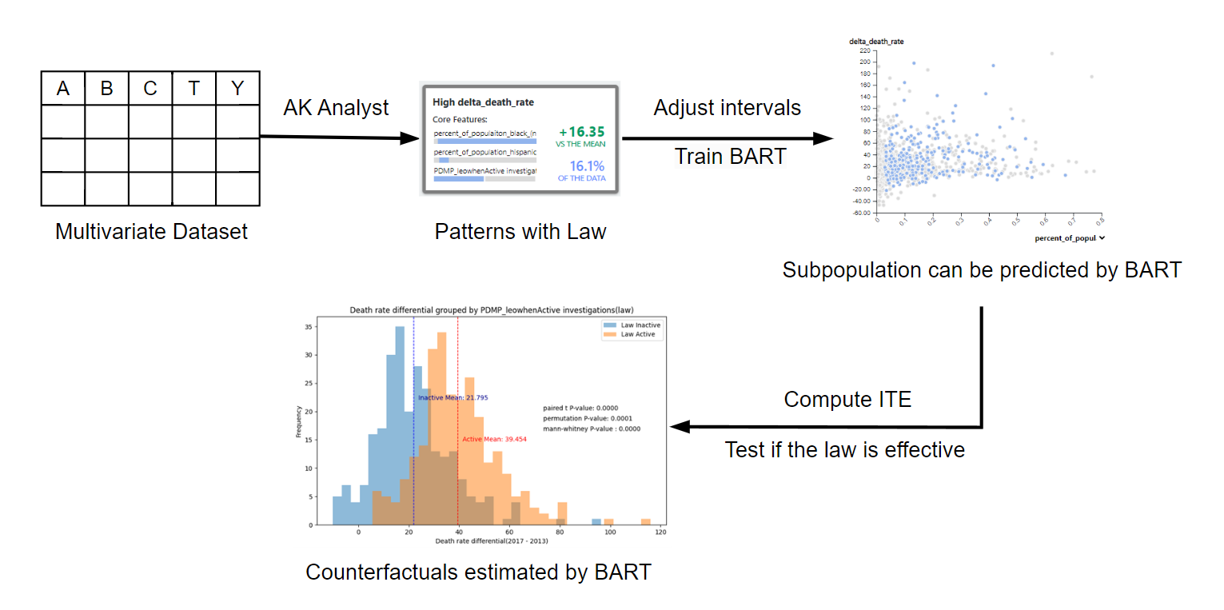
Workflow
As we receive inaccurate models trained on all counties, we instead target on certain subgroups and measure the causal effect of the law(s) on them.

Slide 4
Some Details
Socioeconomic variables:
NORC dataset (National Opinion Research Center), E.g. Economic-Risk-Score, MDsPerCapita
Treatment variables:
Laws from PDAPS, E.g. naaddressoaayn(Does the jurisdiction have a naloxone access law?)
Outcome variable:
Opioid death rate (CDC WONDER database)
The merged dataset contains all socioeconomic variables, the law of interest(treatment), and opioid death rate(outcome). Each data point in the dataset is a U.S. county.
NORC dataset: https://gss.norc.org/us/en/gss/get-the-data.html
PDAPS dataset: https://pdaps.org/
CDC WONDER database: https://wonder.cdc.gov/

Slide 5
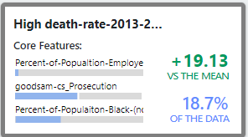
Why Patterns?
Patterns:
Patterns are subpopulations that associate with high/low outcome values.
(formed by combination of Intervals, each pattern is a hyperbox in high dimensional space)
Why estimate within patterns?
An example pattern found by Pattern Miner
Prediction Accuracy (Less noisy region)
Pre-filter interesting laws
More Overlapping (Law classes(0/1) are more balanced)
Patterns are hypotheses that we can test, we need to further confirm if a pattern is useful by checking some metrics of the fitted model such as NRMSE, RMSE, and R-square.

Slide 6
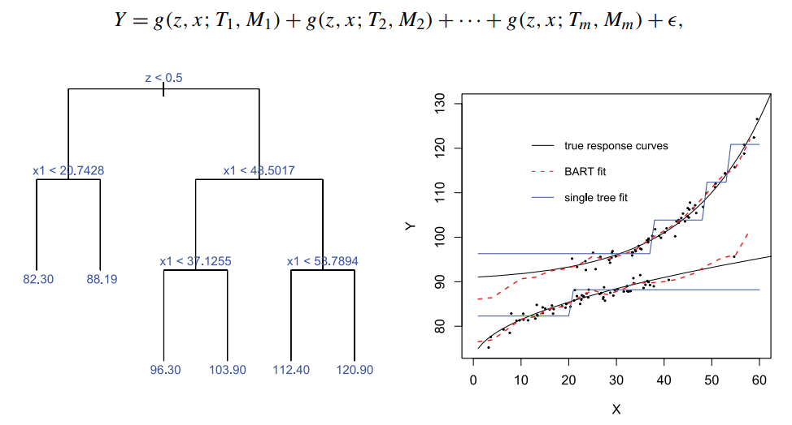
Why BART?
An illustration of BART
If ignorability holds conditional on x, that is, Y(0),Y(1) ⊥ Z | X = x, the,
E[Y(0) | X = x] = E[Y | Z = 0, X = x] = f (0, x) and E[Y(1) | X = x] = E[Y | Z = 1, X = x] = f (1, x).
“In principle, any method that flexibly estimates f could be used to model these conditional expectations. BART has some potentially important advantages over alternative methods such as random forests, boosting, and neural nets.”
Hill, J. L. (2011). Bayesian Nonparametric Modeling for Causal Inference. Journal of Computational and Graphical Statistics, 20(1), 217–240. https://doi.org/10.1198/jcgs.2010.08162

Slide 7
Methodology
Filter Subgroups: From AK Analyst, we select the pattern that at least has one law and has at least one covariate. The subgroup is determined by covariate(s) intervals and the law(s) within the pattern will be tested.
Test Model Reliability: We slightly adjust the intervals and perform k-fold cross validation using metrics like Normalized RMSE. (Model is trustworthy if mean NRMSE<0.2)
Estimate Outcomes: Train a BART model on subgroup data, and estimate death rate differential under both conditions(Law=0 and Law=1, one of them is counterfactual)
Refute Estimates: Perform Permutation Test, Mann-Whitney U Test and Paired Samples t-Test on the estimated samples.

Slide 8
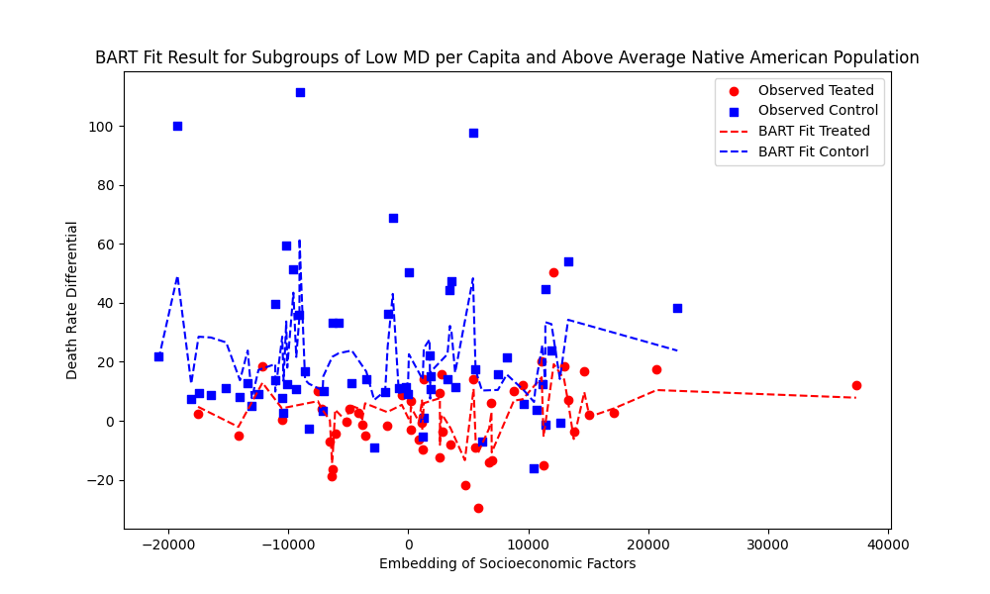
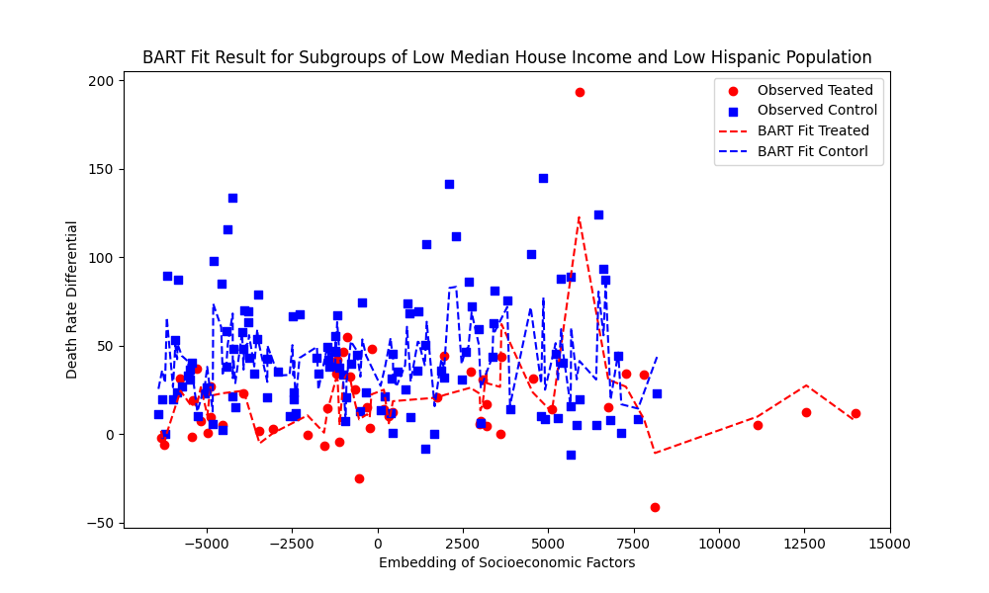
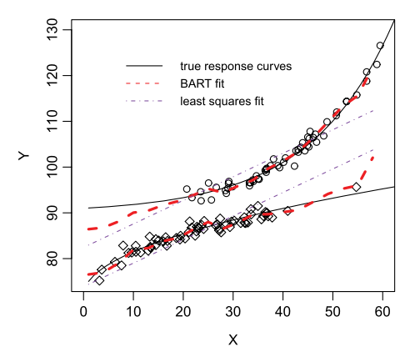
Result
Unlike simulated data, which shows a distinct difference between treated and control groups, estimating the death rate differential, even for subpopulations, is challenging. However, based on the charts, the BART model still provides reasonably accurate results.
An example of BART fit on simulated data

Slide 9
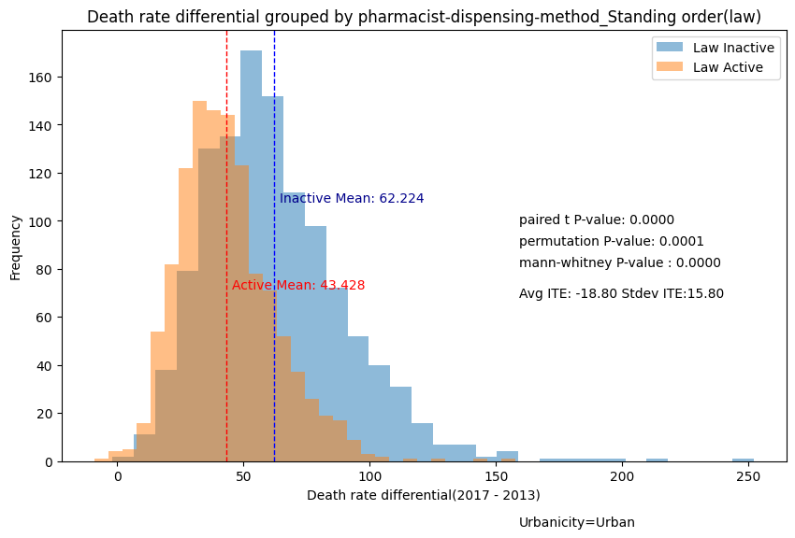
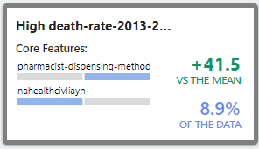
Naloxone Overdose Prevention Laws
Original Pattern
Law is inactive
Pharmacist-dispensing-method_Standing order: How are pharmacists allowed to dispense or distribute naloxone without a patient-specific prescription from another medical professional? (Pharmacists can provide naloxone)
Insight: Pharmacist-dispensing-method_Standing order is a beneficial law for urban counties. When the law is active the mean opioid death rate differential 43.43 whereas the value is 62.22 when the law is inactive. Additionally, Average ITE is -18.80(SD = 15.80).

Slide 10
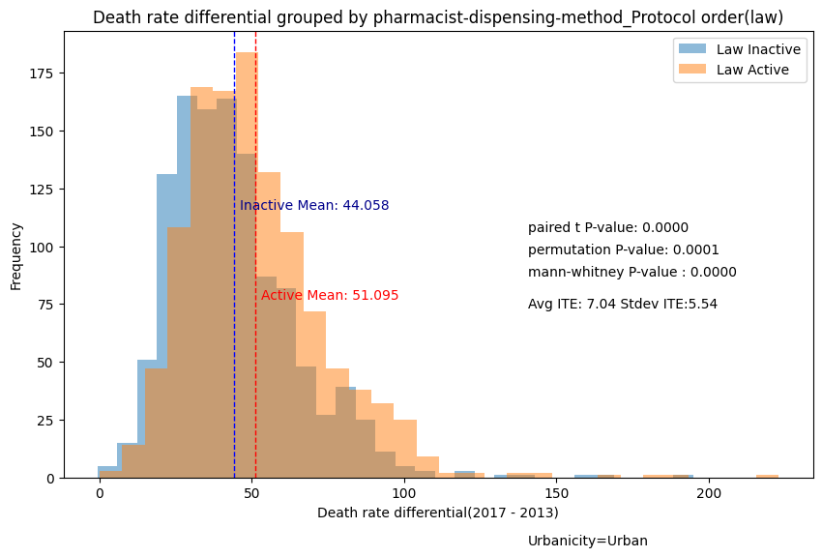
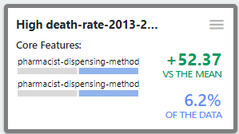
Naloxone Overdose Prevention Laws
Original Pattern
Law is active
Pharmacist-dispensing-method_Protocol order: How are pharmacists allowed to dispense or distribute naloxone without a patient-specific prescription from another medical professional?(More restrictions for pharmacists to provide naloxone)
Insight: Pharmacist-dispensing-method_Protocol order is a harmful law for urban counties. When the law is active the mean opioid death rate differential 51.10 whereas the value is 44.06 when the law is inactive. Additionally, Average ITE is 7.04(SD = 5.54).

Slide 11
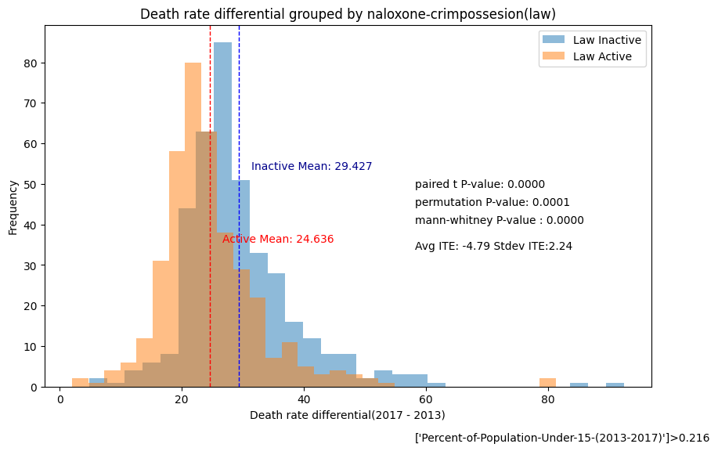
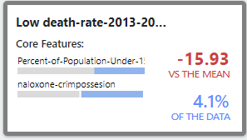
Naloxone Overdose Prevention Laws
Original Pattern
Law is active
Naloxone-crimpossesion: Does the law remove criminal liability for possession of naloxone without a prescription?
Insight: Naloxone-crimpossesion order is a beneficial law for counties with high percent of population under 15 (>0.216(88th percentile)). When the law is active the mean opioid death rate differential 24.64 whereas the value is 29.43 when the law is inactive. Additionally, Average ITE is -4.79(SD = 2.24).

Slide 12
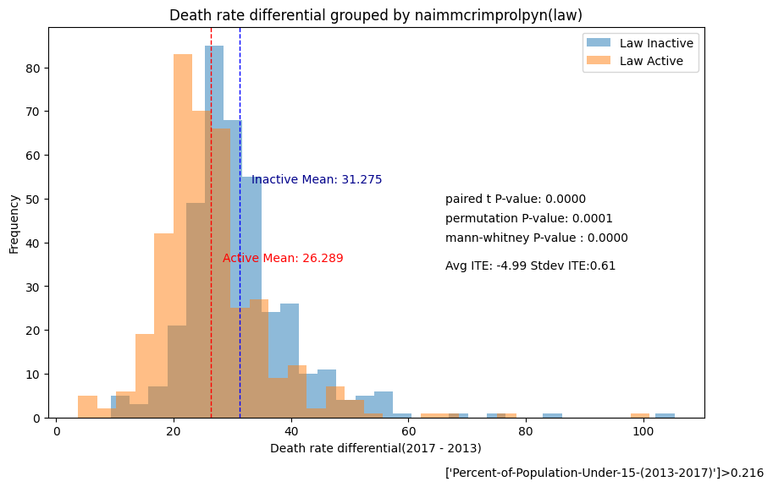
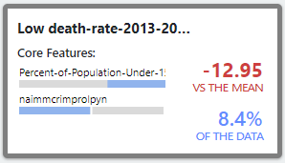
Naloxone Overdose Prevention Laws
Original Pattern
Law is active
Naimmcrimprolpyn: Is a layperson immune from criminal liability when administering naloxone?
Insight: Naimmcrimprolpyn is a beneficial law for counties with high percent of population under 15 (>0.216(88th percentile)). When the law is active the mean opioid death rate differential 26.29 whereas the value is 31.28 when the law is inactive. Additionally, Average ITE is -4.99(SD = 0.61).

Slide 13
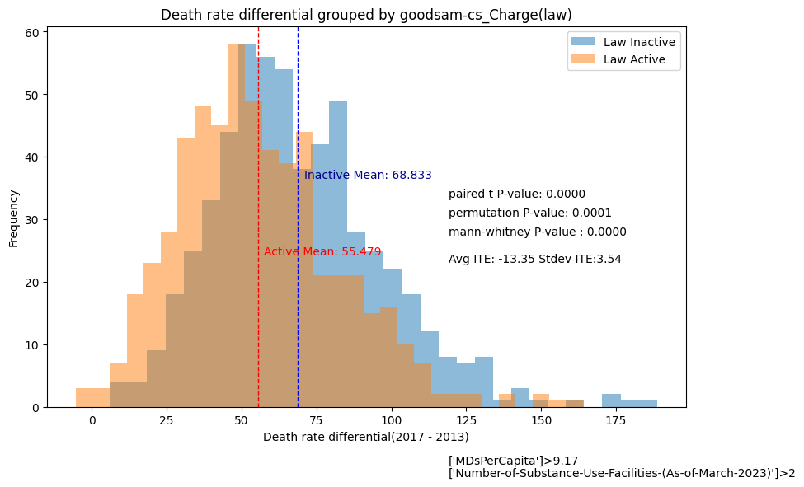
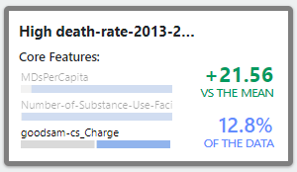
Good Samaritan Overdose Prevention Laws
Original Pattern
Law is inactive
Goodsam-cs_Charge: What protection, if any, does the law provide from controlled substance possession laws?(Protect from charges)
Insight: Goodsam-cs_Charge is a beneficial law for counties with high MDs per capita(>9.17(60th percentile)) and general number of substance use facilities(>2(33rd percentile)). When the law is active the mean opioid death rate differential 55.48 whereas the value is 68.83 when the law is inactive. Additionally, Average ITE is -13.35(SD = 3.54).

Slide 14
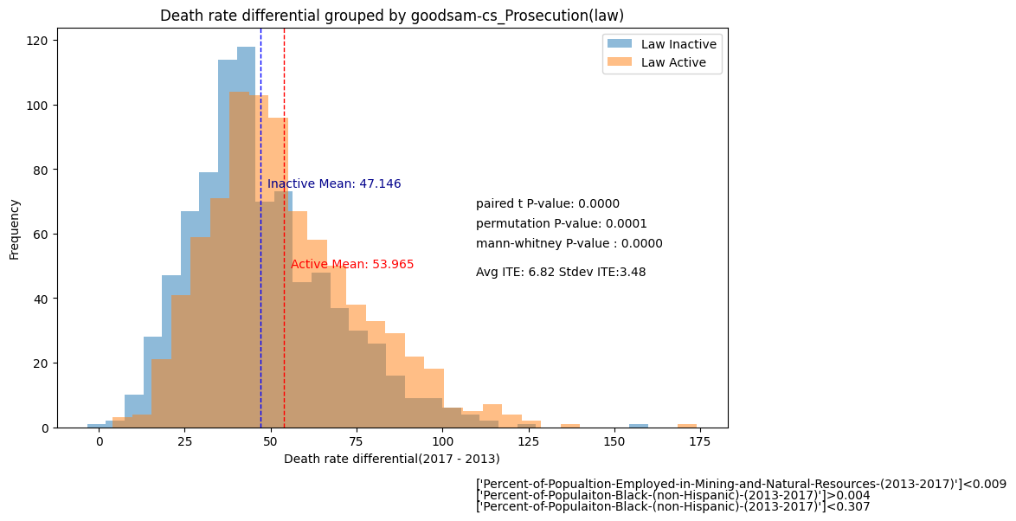
Good Samaritan Overdose Prevention Laws
Original Pattern
Law is active
Goodsam-cs_Prosecution: What protection, if any, does the law provide from controlled substance possession laws?(Protect from prosecution)
Insight: Goodsam-cs_Prosecution is a harmful law for counties with low percent of population employed in mining and natural resources(<0.009(33th percentile)), and general percent of black population ([0.05,0.139](18th-90th percentile)). When the law is active the mean opioid death rate differential 53.97 whereas the value is 47.15 when the law is inactive. Additionally, Average ITE is 6.82(SD = 3.48).

Slide 15
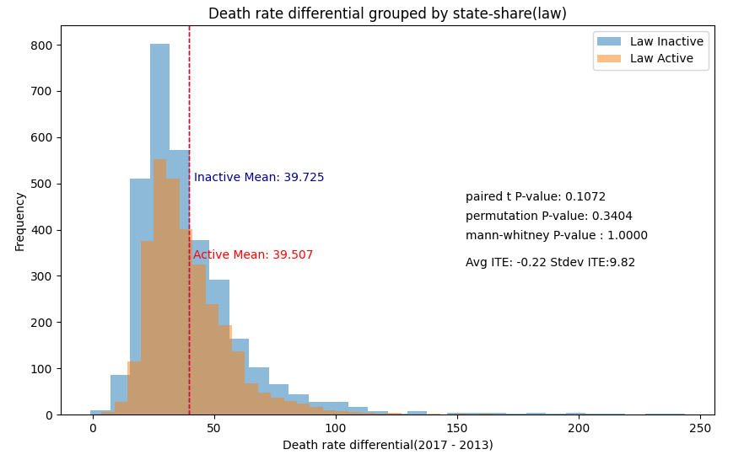
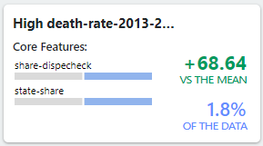
PDMP Reporting and Authorized Use
Original Pattern
Law is inactive
State-share: Does the law permit the PDMP to share data with other state PDMPs?
Insight: State-share does not seem to have an effect on opioid death rate. It failed all hypothesis tests and its computed ITEs are floated around zero(Mean = -0.22, SD = 9.82).

Slide 16
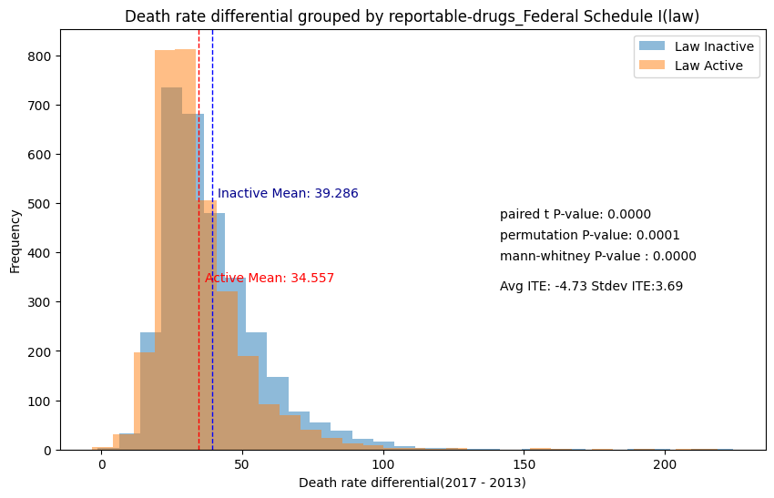
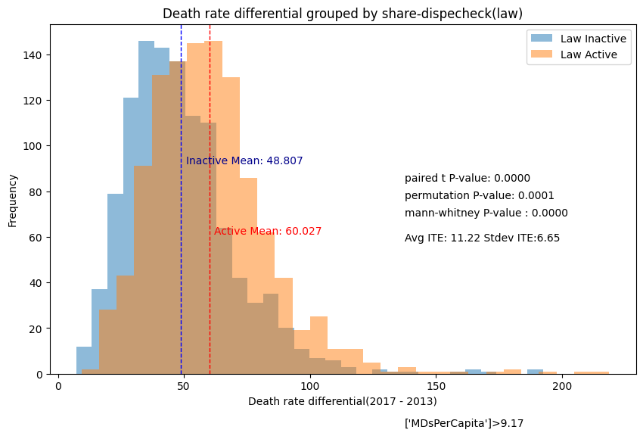
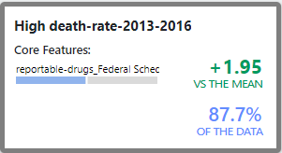
PDMP Reporting and Authorized Use
Original Pattern
Law is inactive
Reportable-drugs_Federal Schedule I: What drug schedules are required to be reported to the PDMP?
Insight: Reportable-drugs_Federal Schedule I is a beneficial law for all counties. When the law is active the mean opioid death rate differential 34.56 whereas the value is 39.29 when the law is inactive. Additionally, Average ITE is -4.73(SD = 3.69).

Slide 17
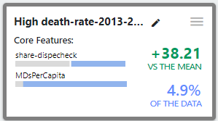
PDMP Reporting and Authorized Use?
Original Pattern
Law is active
Share-dispecheck :Does the state require dispensers to check the PDMP before dispensing controlled substances?
Insight: Share-dispecheck is a harmful law for counties with high MDs per capita(>9.17(60th percentile)). When the law is active the mean opioid death rate differential 60.03 whereas the value is 48.80 when the law is inactive. Additionally, Average ITE is 11.22(SD = 6.65).

Slide 18
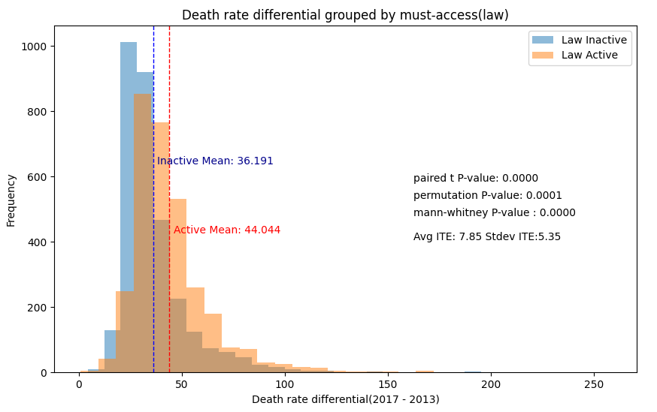
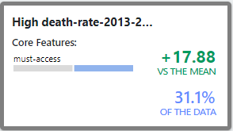
PDMP Reporting and Authorized Use?
Original Pattern
Law is active
Must-access: Does the state require prescribers to check the PDMP before prescribing controlled substances?
Insight: Must-access is a harmful law for all counties. When the law is active the mean opioid death rate differential 44.04 whereas the value is 36.19 when the law is inactive. Additionally, Average ITE is 7.85(SD = 5.35).

Slide 19
Future work
Joint Effect: Up until now, we have only estimated the treatment effect of one law. There are patterns with multiple laws and the effect can be shifted with more than one law.
Adjust Subgroups: By adjusting the intervals, we can get a new subgroup that model can perform better on. This process can be automated.
Reframe the Problem: Stratify death rate differential into low, meidium, high levels. Convert the regression problem into classification problem.

